Slide 1

DS 210 - Introduction to Data Science
Final Project
Miri Eisenberg

Slide 2
Part I

Slide 3
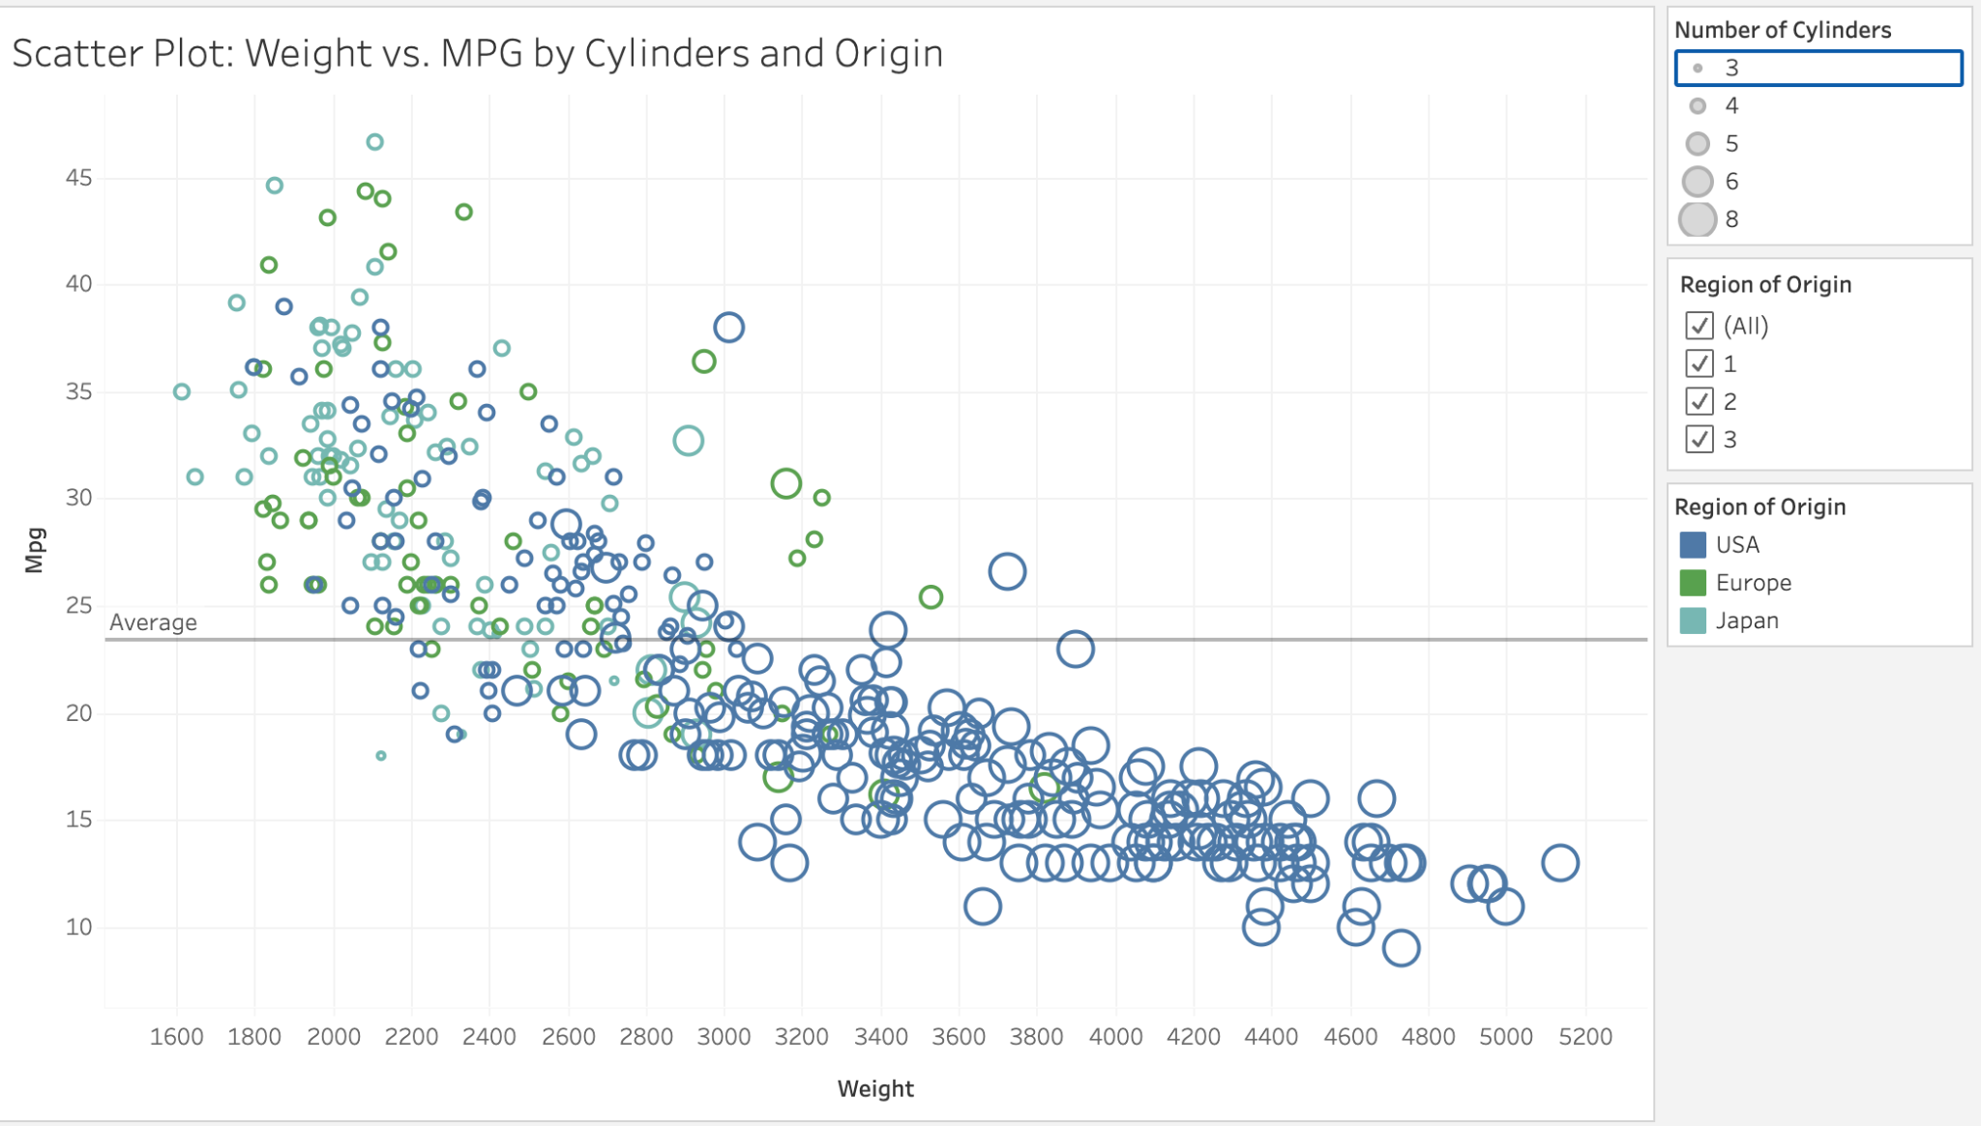
This visualization shows the relationship between car weight and fuel efficiency MPG. It also shows the differences by region of origin (USA, Europe, Japan) and engine size (number of cylinders). Lighter cars generally have higher MPG, for example Japanese and European cars are more fuel-efficient and lighter. American cars are usually heavier with lower MPG. The size of the circles represents the number of cylinders, showing that cars with larger engines - more cylinders are typically heavier and less efficient. The dropdown filters allow you to sort by origin and size of cylinders.
https://public.tableau.com/views/DS210/Sheet1?:language=en-US&:sid=&:redirect=auth&:display_count=n&:origin=viz_share_link

Slide 4
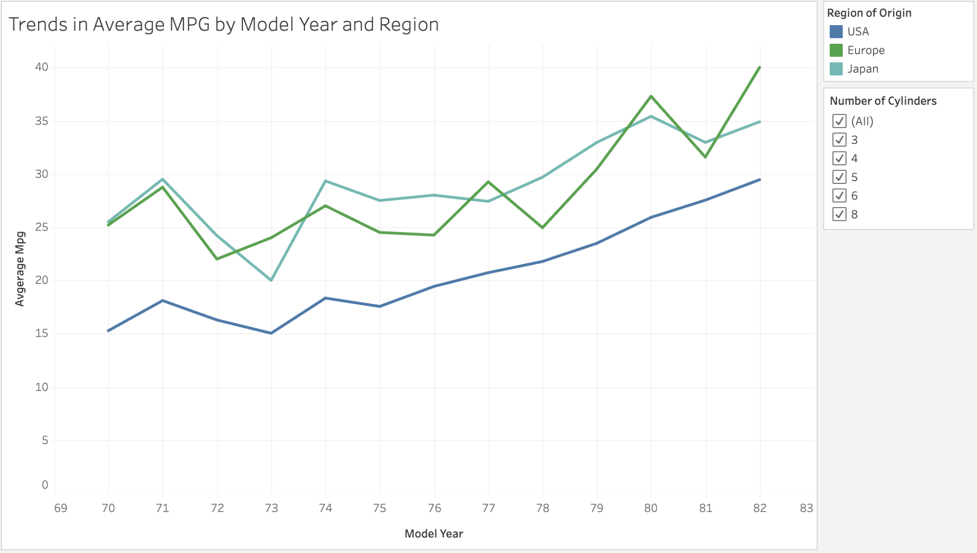
This visualization shows how the average MPG has changed over time (by model year) for cars from different regions - USA, Europe, and Japan. It uses line charts to compare trends, revealing regional differences in fuel efficiency improvements. You can see if Japanese cars improved faster than American cars or if certain years shifted. The visualization shows how advancements in car design and regulations impacted fuel efficiency across regions. The filter allows you to see where the engine size changed over time. This visual shows how MPG has improved over the last few years.
https://public.tableau.com/views/VIS1_17348386851000/Sheet2?:language=en-US&:sid=&:redirect=auth&:display_count=n&:origin=viz_share_link

Slide 5
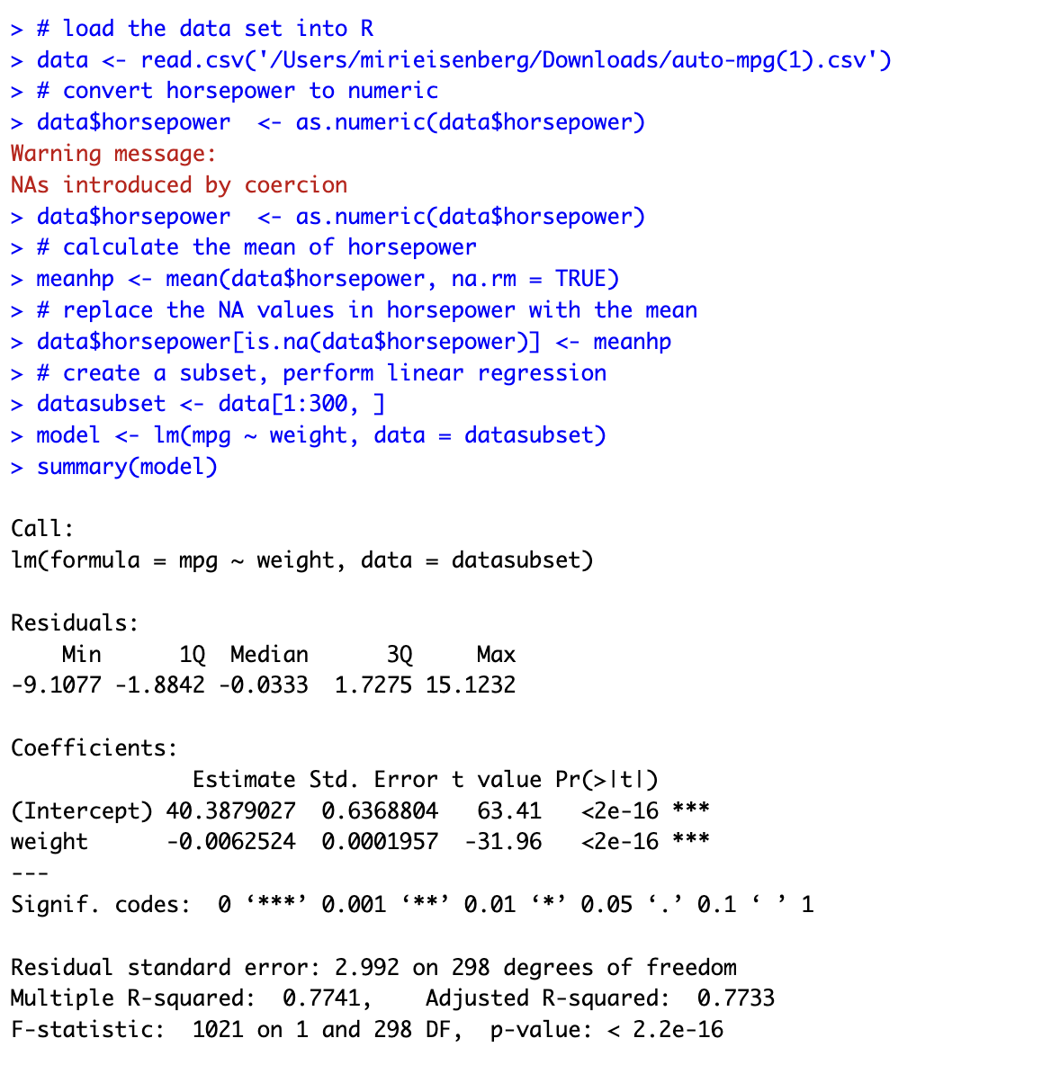
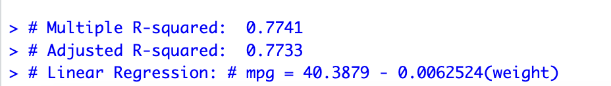

CODE
RESULT

Slide 6

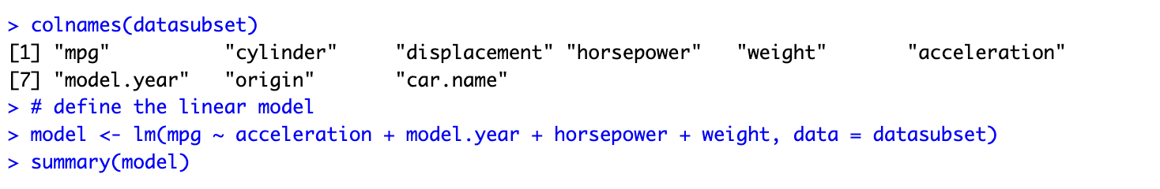
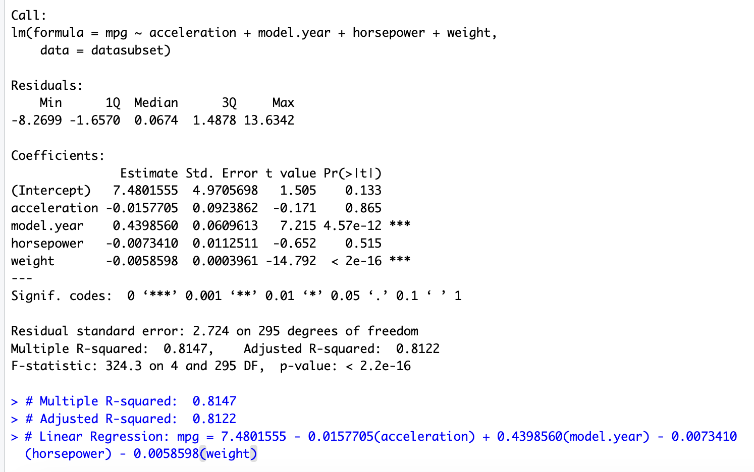
CODE
RESULT

Slide 7
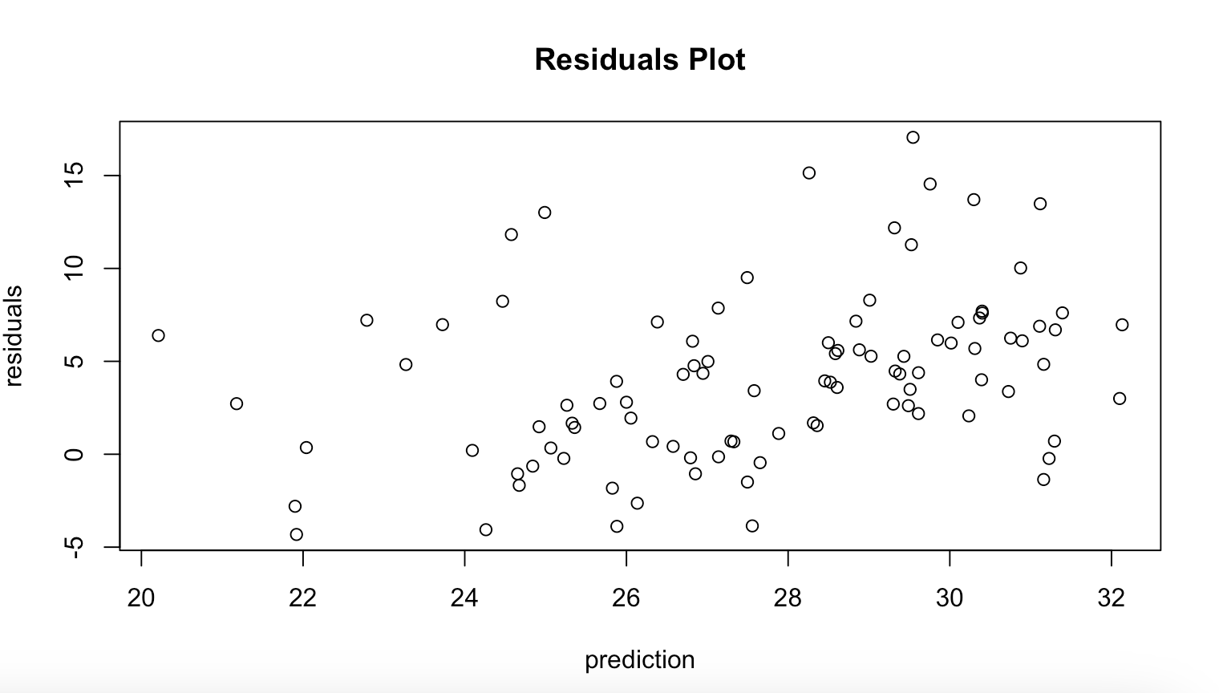
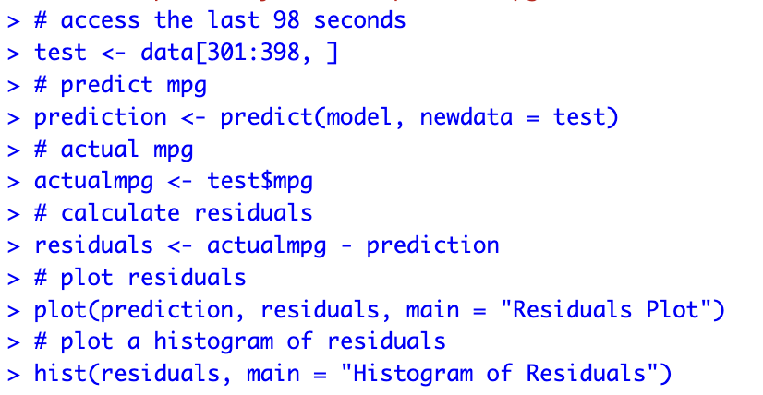
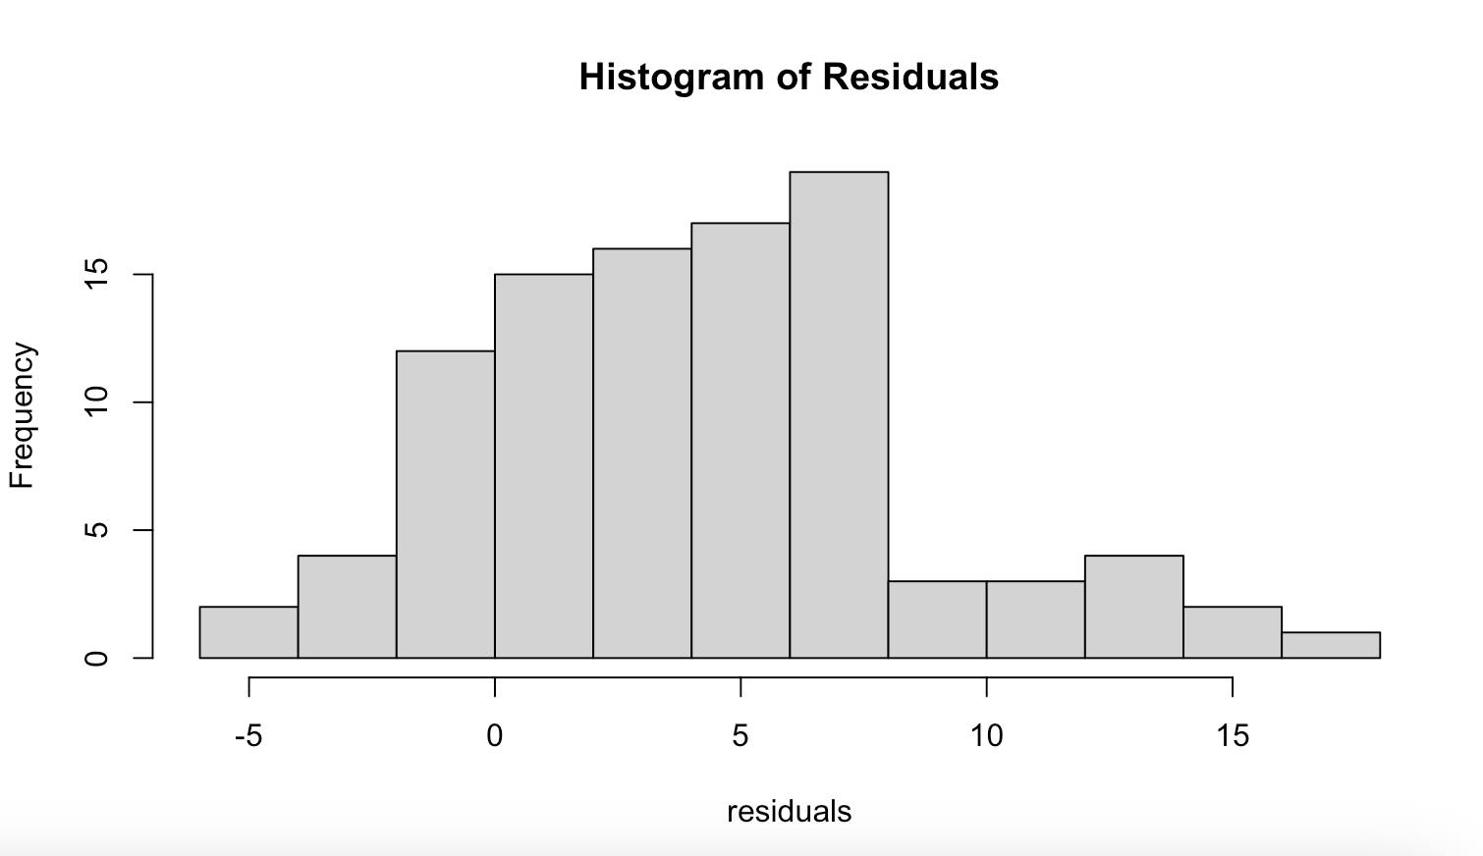
Residuals

Slide 8

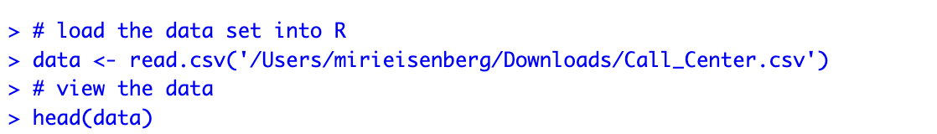
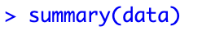

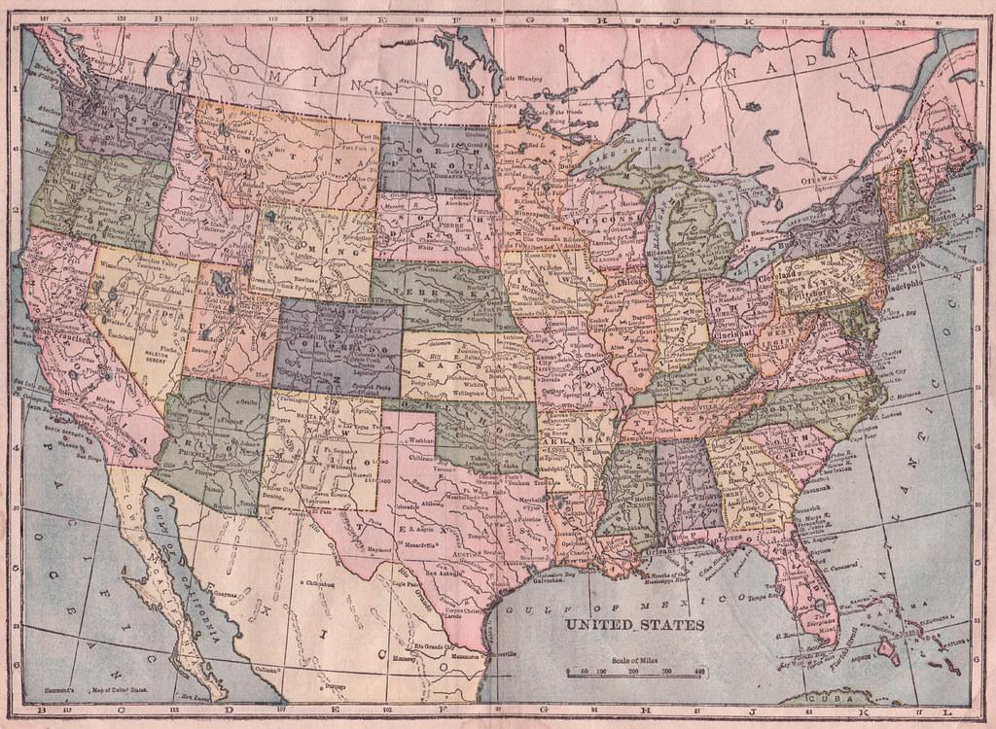
Part II
Loading The Data

Slide 9
What is the relationship between response time and customer satisfaction (CSAT)?

Slide 10
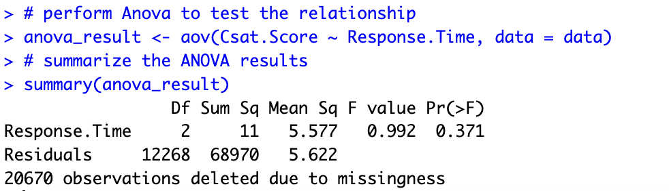
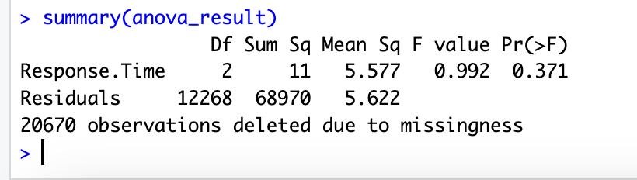
CODE
P-value = 0.371. This number is greater than 0.05 which means that we fail to reject the null hypothesis. Practically speaking this means that there is no strong evidence between the Response time and customer satisfaction. If the p-value would have been less than 0.05 we would see a strong correlation between response time and customer satisfaction.
RESULT
Df (degrees of freedom) = 2. This means that there are 3 levels/categories to response time - we find this by using the equation n-1.

Slide 11
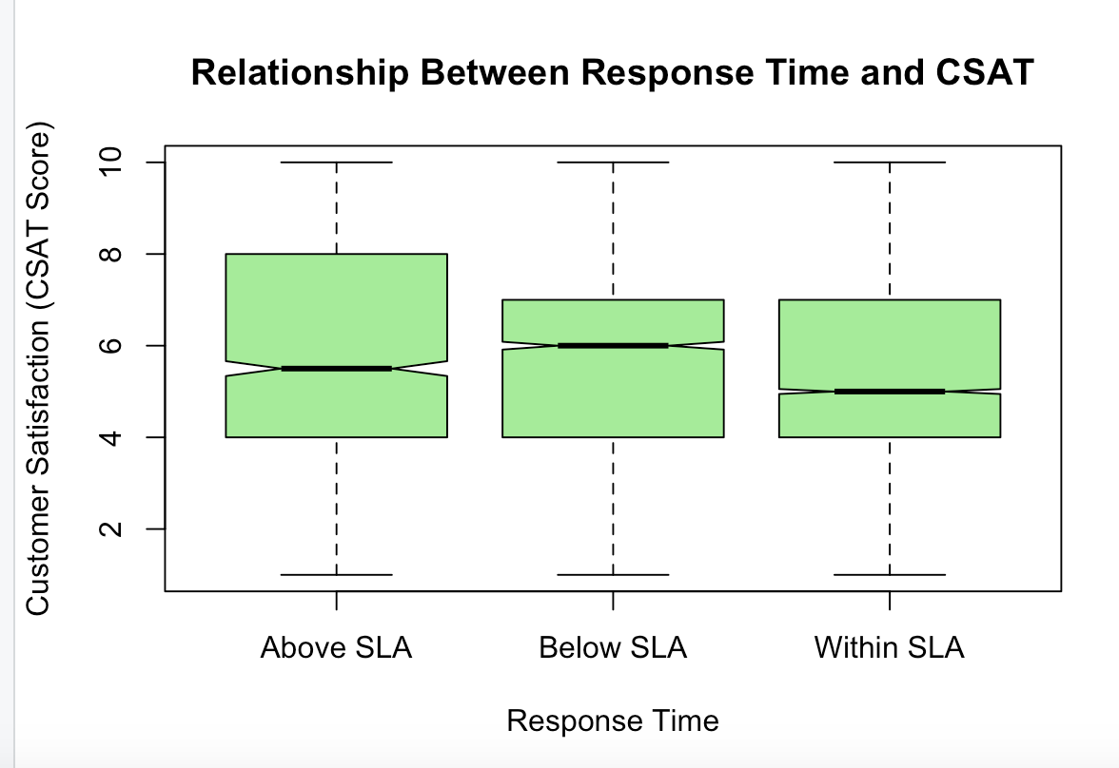
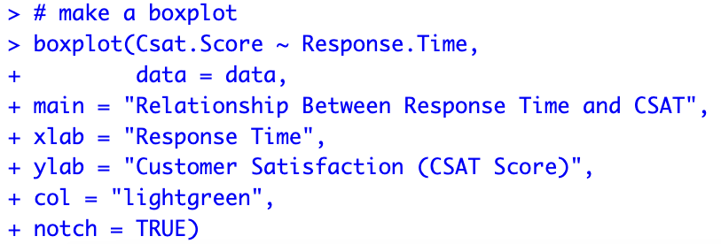
VISUALIZATION
The Medians are similar in all three groups, showing that all groups have similar customer satisfaction scores.
The boxes are similar sizes (above SLA is a little larger) showing that the range of Customer Satisfaction scores are similar throughout the group. This further shows that response time does not affect customer satisfaction.
This boxplot does not have any outliers showing consistent responses.

Slide 12
What are the most common reasons for calls, and how do they impact CSAT?

Slide 13
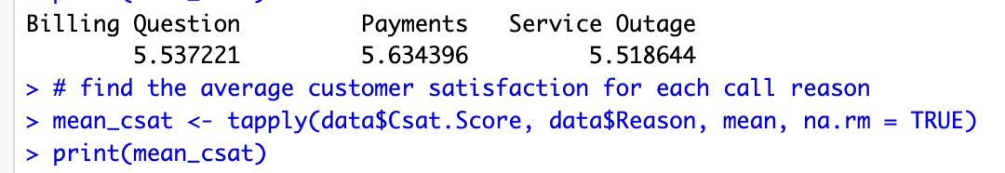

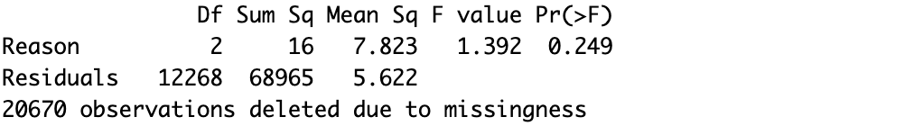
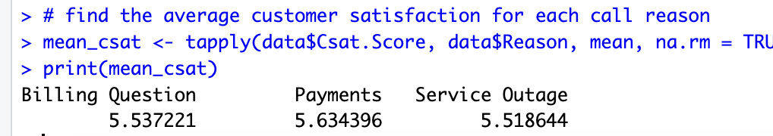
CODE
The most common calls relate to Billing Questions, and the least common calls relate to service outage
P-value = 0.249. This number is greater than 0.05 which means that we fail to reject the null hypothesis. Practically speaking this means that there is no strong evidence between the Customer satisfaction and reasons for calls. If the p-value would have been less than 0.05 we would see a strong correlation between customer satisfaction and reasons for calls.
RESULT
The means are similar to each other, strengthening the conclusion that reasons for calls do not impact customer satisfaction.

Slide 14
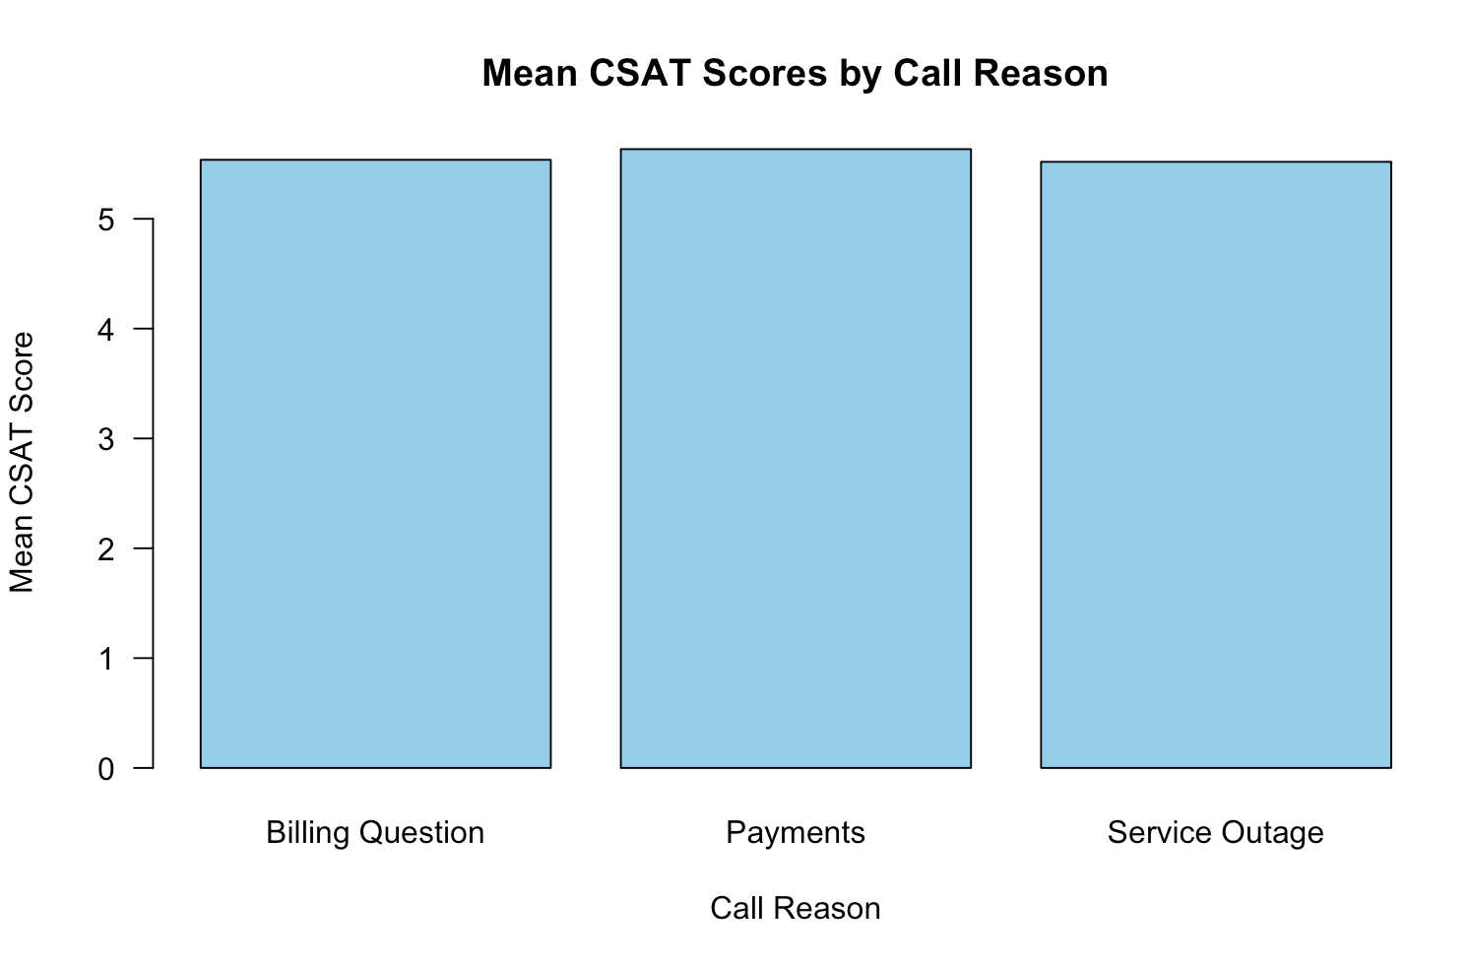
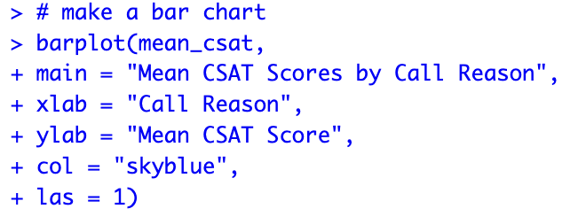
VISUALIZATION
The heights of the bars are almost exactly the same three groups, showing that there is only a very slight difference in customer satisfaction scores between the reasons for calls.
The overall customer satisfaction score is around 5.5 which shows that customers are neutral or slightly unsatisfied.
There is no meaningful correlation.
This bar graph does not have any outliers.

Slide 15
Is there a correlation between the number of calls received in a city and the average call duration for that city?

Slide 16
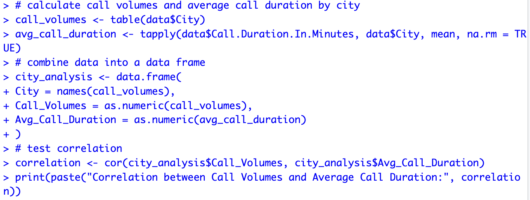
CODE
The correlation coefficient is -0.0319118909606178 which is close to 0. This indicates that there is no meaningful correlation between call volumes and average call duration. This proves that the number of calls a city handles does not significantly affect how long the calls last.
The slight negative value means that as call volumes increase, average call durations may slightly decrease, but this relationship is insignificant.
RESULT

Slide 17
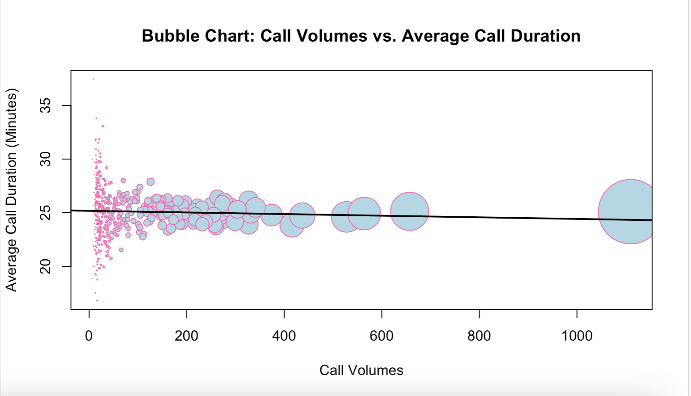
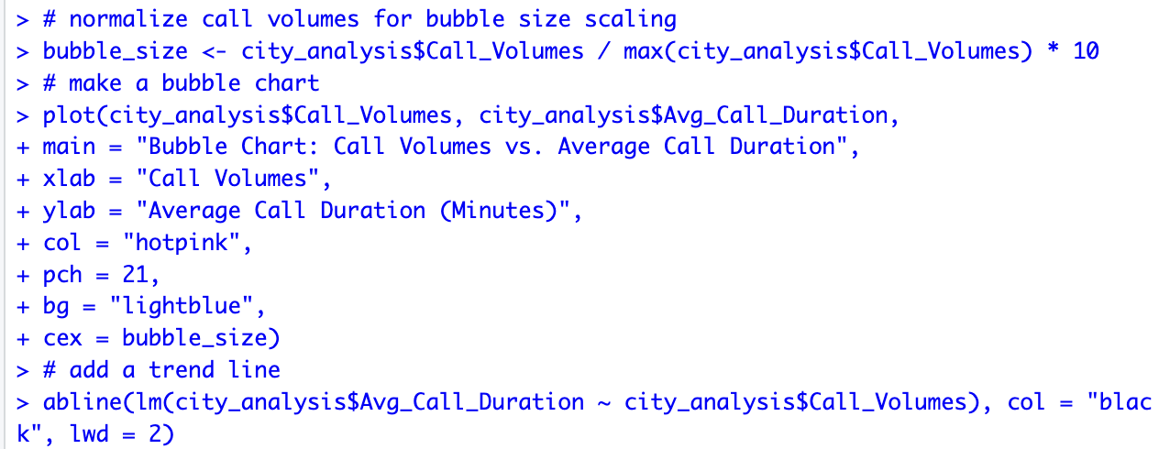
VISUALIZATION
The slight slight downward slope of the trend line suggests a weak correlation between call volumes and average call duration. This aligns with the correlation coefficient, which indicates no significant linear correlation.
The X-axis represents the total call volumes for each city. The Y-axis represents the average call duration in minutes. The black trend line shows the relationship between the two variables.
The size of the bubbles is proportional to the call volumes in each city. The bigger the bubble, the more calls a city gets.
The city with around 1,000 calls sticks out however the duration of the calls which are around 25 minutes is the same as the cities with fewer calls.

Slide 18
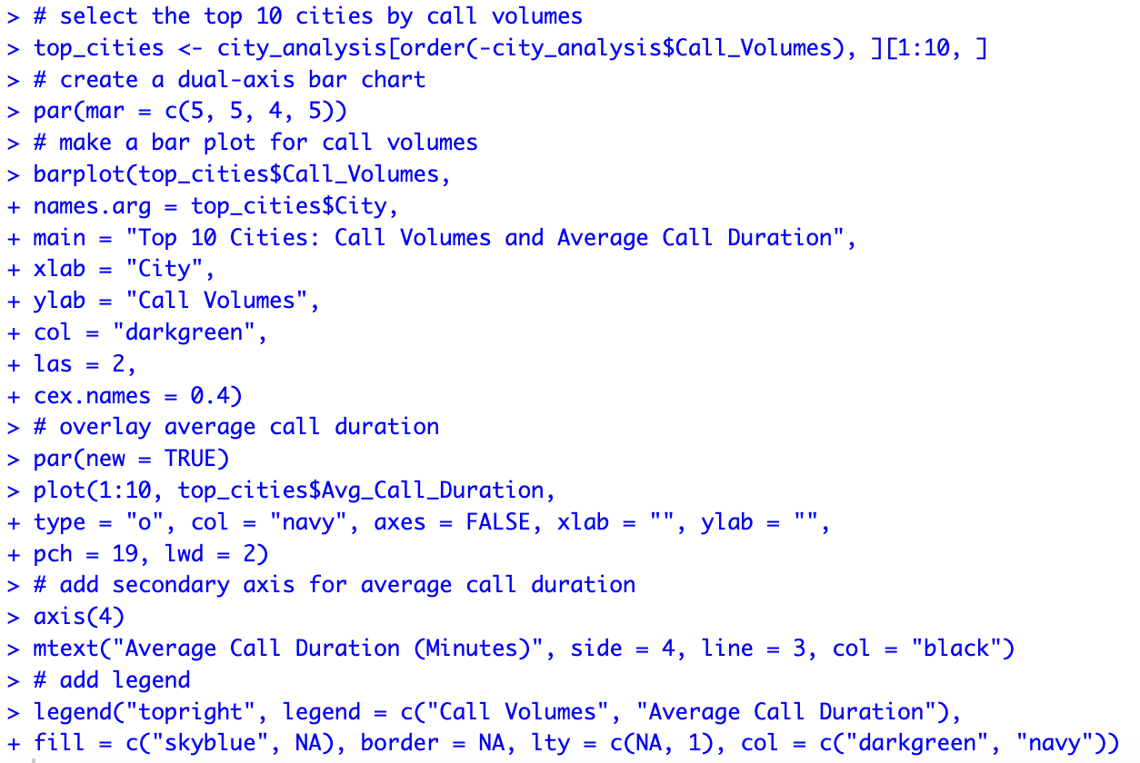
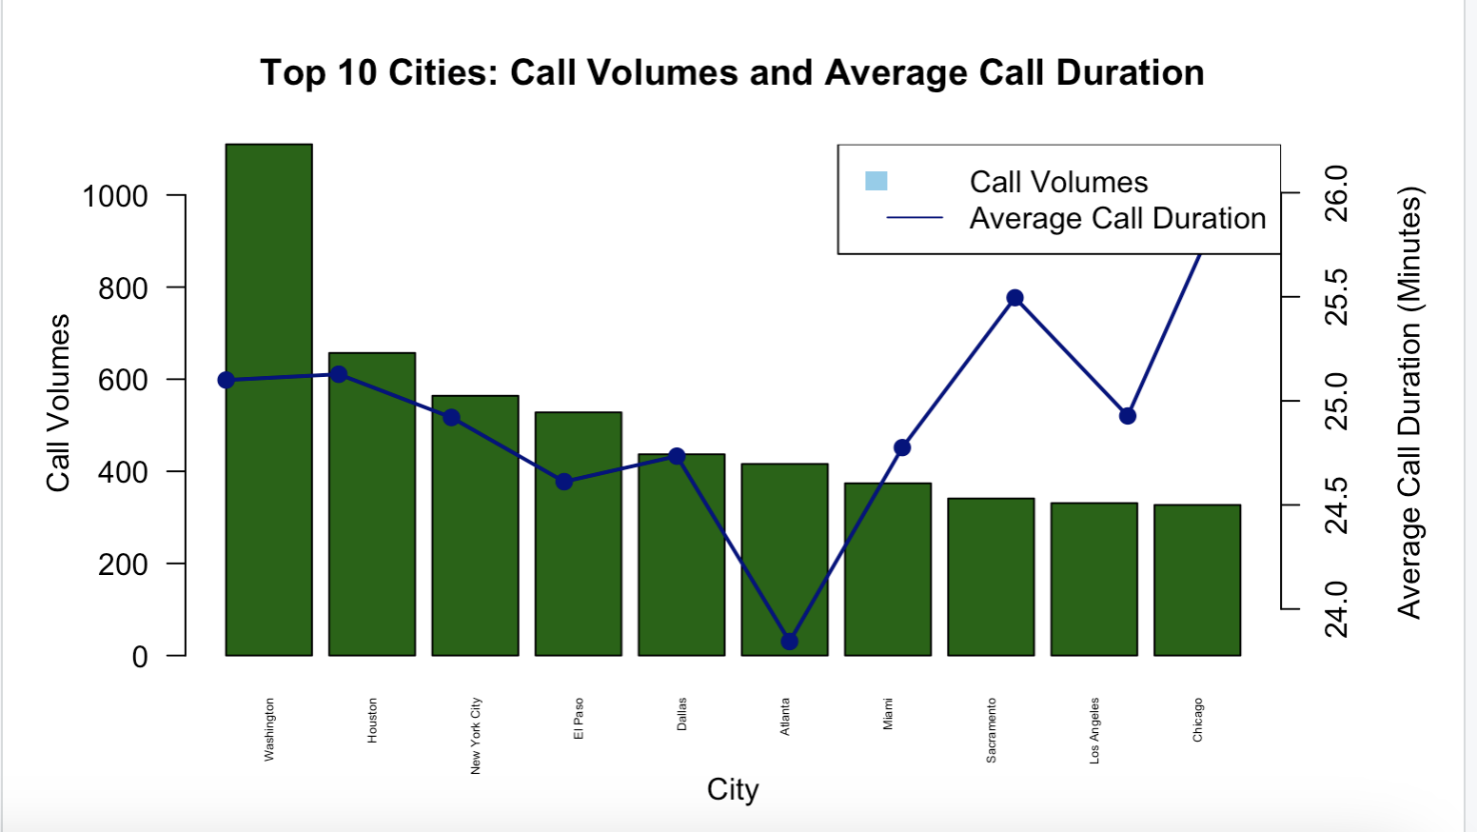
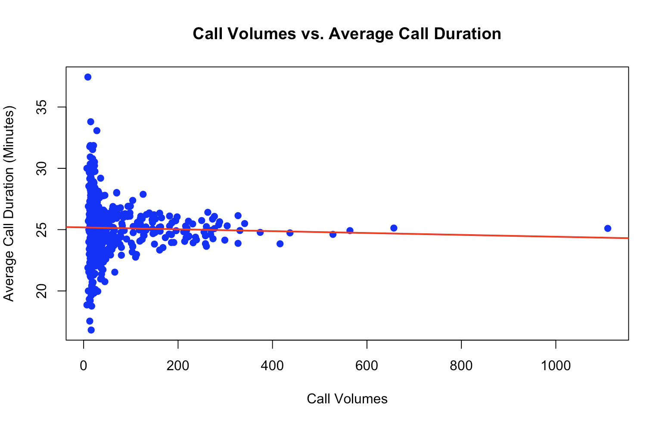
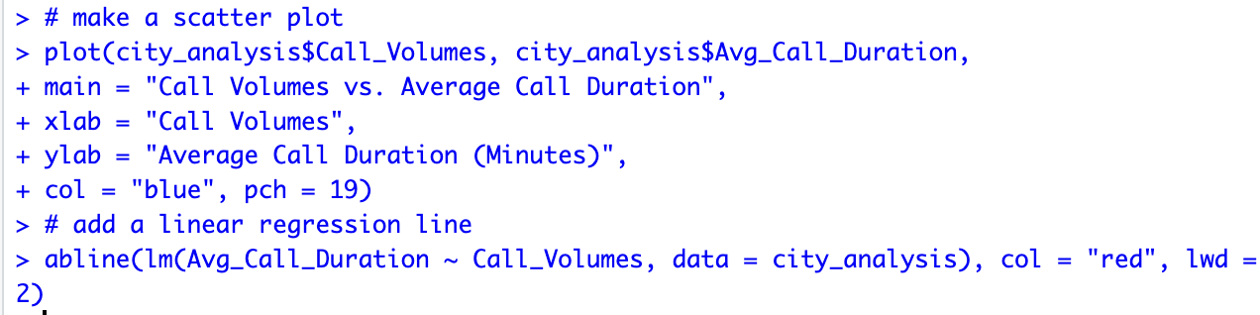
Washington, Houston, and New York City have high call volumes with consistent call durations proving efficiency.
Atlanta has a higher average duration despite low call volumes, suggesting inefficiencies or complex calls.
The scatter plot shows no clear trend, with call durations remaining stable regardless of call volumes.

Slide 19
Optimizing Businesses
Is there a correlation between the number of calls received in a city and the average call duration for that city?
What is the relationship between response time and customer satisfaction (CSAT)?
What are the most common reasons for calls, and how do they impact CSAT?
Use high-volume cities with stable durations as benchmarks for best practices. Address inefficiencies in low-volume cities with higher durations through process improvements or training. Base staffing decisions on call complexity and type, not just volume.
Since response time has little impact on CSAT, focus should shift to resolving issues effectively on the first interaction by improving agent behavior, communication, and resolution clarity. SLA targets can be adjusted to optimize efficiency and reduce costs without affecting satisfaction.
Improve processes across all call types by addressing systemic issues like resolution quality, communication, and agent training. Prioritize proactive communication for Service Outages and provide targeted training to handle Billing Questions and Payments more effectively.

Slide 20
Part III
Github

